Slide 1
Diabetes Prediction using ML
Abhimaan Mayadam

Slide 2
Outline
Introduction
Descriptive Statistics
Machine Learning
Results
Final Takeaways

Slide 3
Introduction
Diabetes affects a large portion of the world
Both as a direct disease and the increased risks to health

Slide 4
Diabetes Diagnosis using ML
My term project is focusing on the diagnosis and trying to predict diabetes using machine learning.

Slide 5
Pima Indians dataset
Collected in the mid to late 90s in Phoenix, Arizona
768 observations on 9 variables

Slide 6
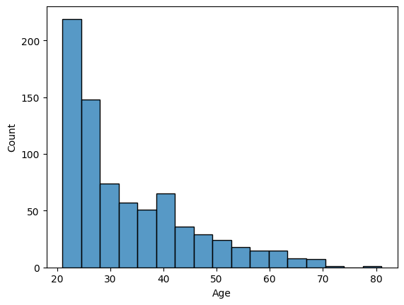
Age Distribution of Pima Indians

Slide 7
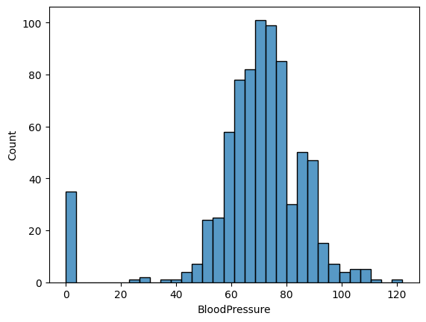
Blood Pressure distribution

Slide 8
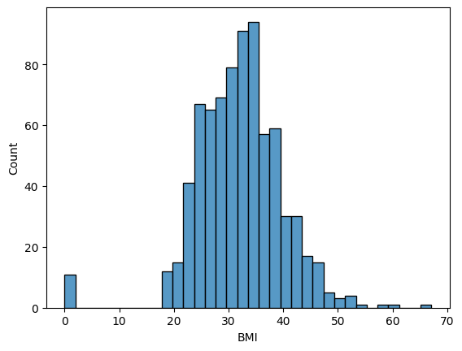
BMI distribution

Slide 9
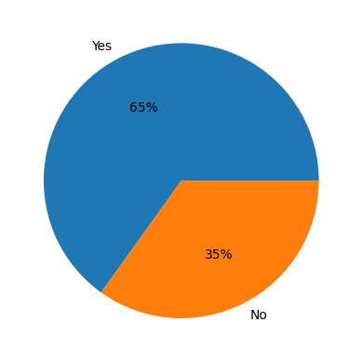
Diabetes Spread

Slide 10
Machine Learning
Models Chosen:
Naïve Bayes
Decision Tree
Untuned and Tuned

Slide 11
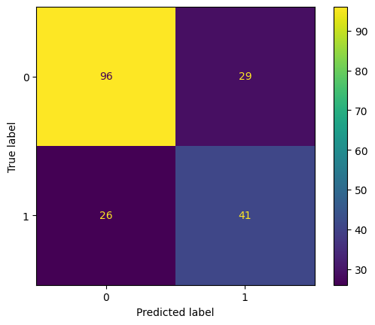
Naïve Bayes
Gaussian Naïve Bayes model was chosen
75/25 split used for training
Accuracy: 0.750
Precision: 0.642
Recall: 0.642
F1 Score: 0.642

Slide 12
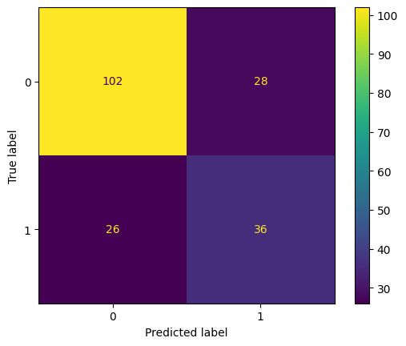
Decision Tree
Variables were minmax scaled
Untuned
Accuracy: 0.719
Precision: 0.562
Recall: 0.581
F1 Score: 0.571

Slide 13
Decision Tree
Variables were minmax scaled
Tuned
Accuracy: 0.73955
Precision: 0.646482
Recall: 0.631475
F1 Score: 0.633318

